Slide 1

Technical Weekly Report | EDBD | W06 21/Jan – 03/Feb/2022
Item | Content | Page
Improvement | Study of improvement of the storage performance by improving the corrosion resistance of zinc cans | 2
Development | The new carbon rod (C/R) with high melting point wax | 3
Deign of materials/ component parts | Safety of R6 tube battery without cap; Safety evaluation | 4
Deign of materials/ component parts | Safety of R6 tube battery without cap; Simulation of higher internal pressure by CAE | 5
Benchmarking | Performance evaluation of Competitor in the Peru Market | 6

Slide 2
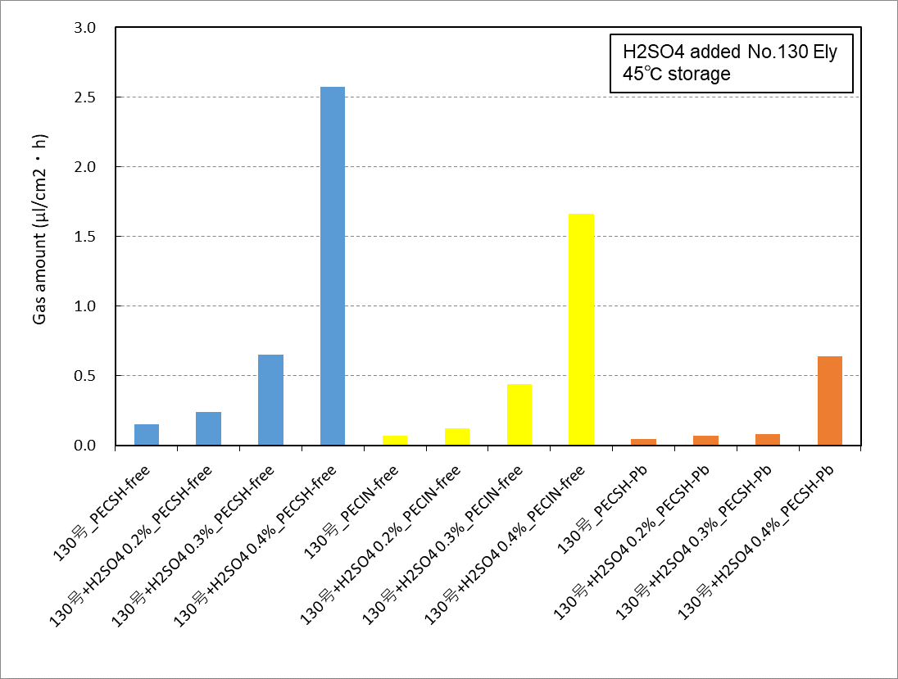
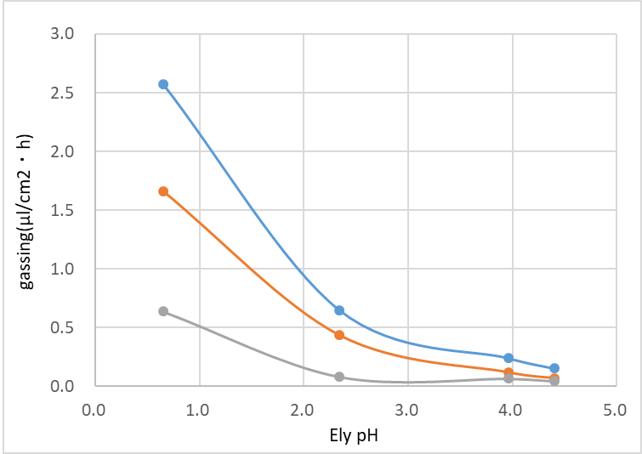
Technical Weekly Report | EDBD | W06 21/Jan – 03/Feb/2022
2
Item/
Study of improvement of the storage performance by improving the corrosion resistance of zinc cans 【Background and Purpose】 ・After changing the lead-no added zinc can, the long-term storage performance at room temperature tend to deteriorate. ・In particular, PECSH batteries using lead-no added zinc materials from other company have been complaining about performance degradation at an early stage. ・In W51, we reported that increasing the amount of zinc oxide in MIX could be expected to increase the pH of MX and suppress corrosion of zinc cans during storage. ・This time, we report the result of gas generation of a zinc can in electrolyte in which sulfuric acid was added and the pH was adjusted. 【Contents】 Electrolyte prescription: No. 130 electrolyte, added sulfuric acid 0.0-0.4% Zinc cans: PECSH (VINNIC), PECIN lead-free zinc cans (in-house zinc cans), PECSH lead-added zinc cans (VINNIC) Gas generation test during storage (corrosion test): Stored at 45℃ 【Results】 -The amount of gas generation of lead-free zinc cans was equivalent to that in lead-added zinc cans in No.130 electrolyte, but they tended to increase sharply at low pH. -In particular, PECSH lead-free zinc cans showed a large amount of gas generation. -These results showed the same tendency as the result of the amount of zinc oxide in MIX and the amount of gas generated from the battery in W51. ⇒We plan to reconsider the amount of In and Bi added to improve the low pH resistance of zinc cans. 【Future plans】 ・Reconsideration of zinc can composition ・Investigation of the effect of zinc oxide addition on battery characteristics
Fig1. The results of gas generation of storage zinc can in the
electrolyte

Slide 3
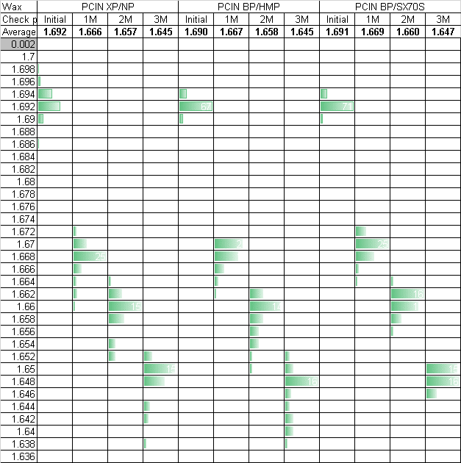
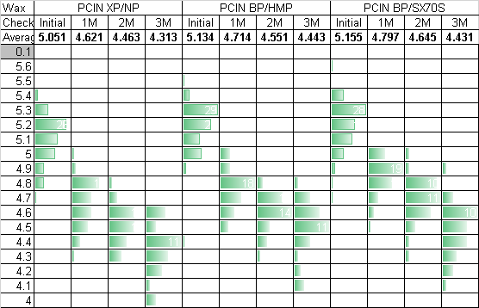
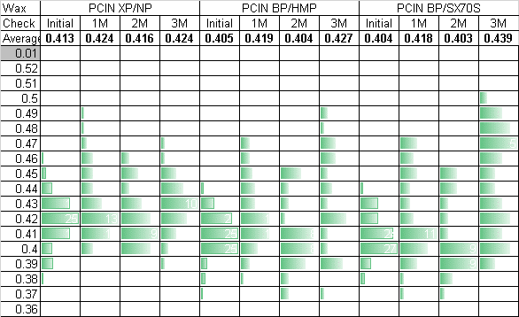
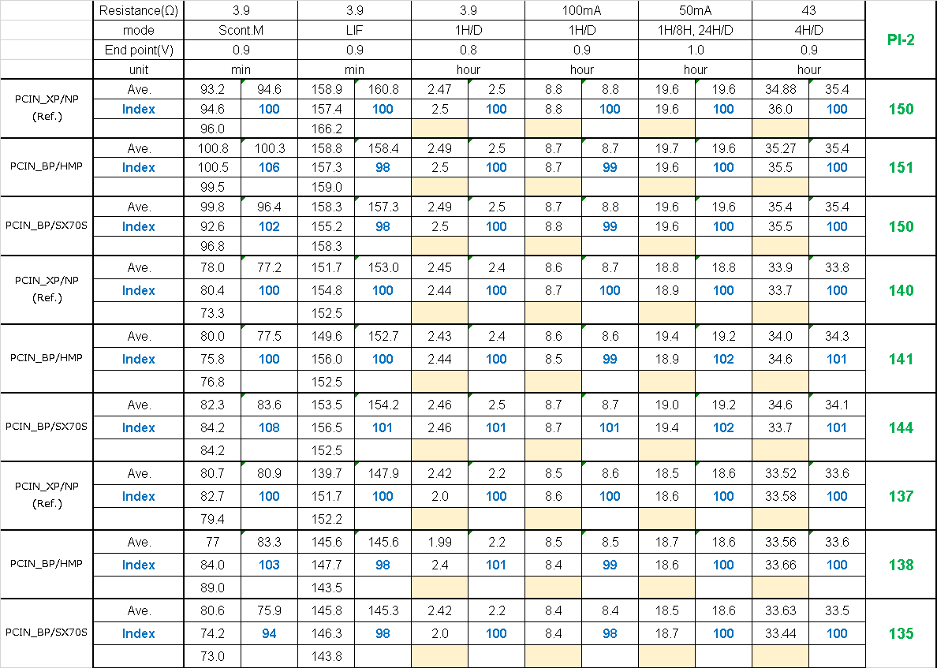
Technical Weekly Report | EDBD | W06 21/Jan – 03/Feb/2022
3
Item/
【Title】 The new carbon rod (C/R) with high melting point wax 【Back ground】 ・Zinc-carbon battery is difficult to use after 60℃ storage because it has the risk about electrolyte leakage. Carbon rod is degraded in 60℃ because of melting paraffin it works for waterproof material. ・I try to use the high melting point wax to improve storage performance in high temperature (about 60℃). 【Material】 Synthesis paraffin wax made by Shell. Grade : SX70S 【Evaluation】 ・Carbon rod property (Reported in W41 2021) ・Storage test for Sealant viscosity (Reported in W41 2021) ・Battery performance (Partial report in W41 2021 and W49) Cell type : R6 tube cell in PECIN Cathode : EMD(Zhongxin)/GCA(Denka)=6.0 ZnO additive is 1.5% as EMD weight. Electrolyte : No.130 with 500ppm LC-200 ・I evaluated 3 C/R in the below table.(Table.1) Table.1 C/R sample information. 【Results】 ・OCV variation after storage is more stable than PCIN current. ・Discharge performance is similar as PCIN current before and after storage. | 【Consideration】 ・SX70S have better sealant storage performance than PCIN current(W41 2021). So OCV degradation caused by flowing in air and Zinc can corrosion. 【Further action】 ・Cap corrosion ・Evaluation moisture of cathode after storage. Fig.1 Static property before and after 45℃ storage. ●OCV ●SCC ●IR Table.2 Discharge performance before and after 45℃ storage.
RT
Initial
 | Grade | Wax | M.P（℃）
① | R6 XP | Normal paraffin(PCIN current) | 60-62
② | R6 BP | HMP paraffin(PCIN current) | 66-68
③ | R6 BP | Synthesis paraffin wax SX70S | 70-72
45℃
1M
45℃
3M

Slide 4
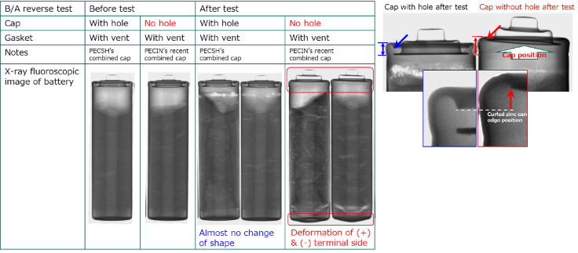
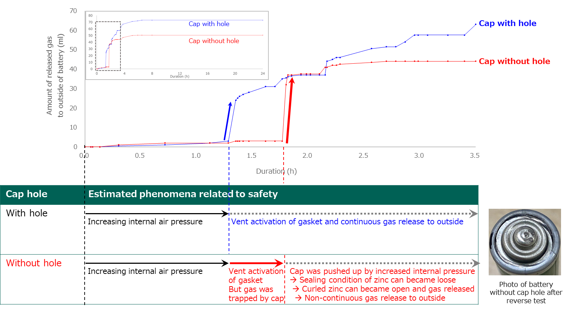
Technical Weekly Report | EDBD | W06 21/Jan – 03/Feb/2022
4
Item/
R6 tube battery without cap hole safety evaluation [Back ground & Objective] In current tube type battery of Panasonic, every battery has vent on gasket and hole on cap to release gas to outside. Recently, PECIN asked us about possibility of removing hole on cap. And we evaluated the safety of R6 tube type battery without gas hole. As a result of safety test and X-ray fluoroscopy analysis, we confirmed that the batteries without cap hole didn’t explode after reverse test but sealing condition (Zinc can curling) of the battery was loosed. This time, we analyzed detailed mechanism of how the gas is released to outside from the battery without cap hole. [Sample] 1) R6 tube battery with cap hole 2) R6 tube battery without cap hole [Evaluation] Measuring released gas amount in ¼ reverse test [Result] Table 1 shows ¼ reverse test results and Table 2 shows result of X-ray fluoroscopy. *Already reported in previous report Fig. shows transition of measured gas released amount to outside of battery. As a result of measuring released gas amount in ¼ reverse test, difference of duration until gas release was observed between the battery with cap hole and that without hole. And The battery without cap hole is slower to release gas than the battery with cap hole. This result indicates that gas have trapped by cap without hole after vent activation of gasket and it caused further increasing internal pressure. And this is the estimated cause of loosed sealing condition (Zinc can curling)after reverse test. We already informed these result to PECIN. And PECIN is considering re-introduction of cap hole to R6 tube battery
Table 1 Initial discharge performance
Trial battery |  | EDBD Lab. R6 tube battery Gasket with vent EMD100% & M/C=6 prescription
Booster battery |  | PECGI R6 NWC (EMD100%, M/C=6)
 |  |  | Cap
 |  |  | With hole | Without hole
 |  | Explosion* | 0/3 | 0/3
 |  | Cap protrusion | 0/3 | 0/3
 |  | Increasing T.H. | 0/3 | 3/3
 |  | Leakage | 2/3 | 2/3
 |  | Δ T.H. after | 0.0 | 2.3
 |  | safety test | 0.1 | 1.2
 |  | (mm) | 0.1 | 2.6
 |  | Ave. | 0.1 | 2.0
 |  | Δ S.H. after | 0.3 | 0.8
 |  | safety test | 0.3 | 0.4
 |  | (mm) | 0.0 | 1.0
 |  | Ave. | 0.2 | 0.7
Table 2 Static characteristics
Fig. Released gas amount

Slide 5
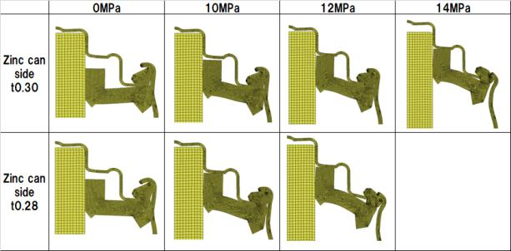
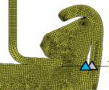
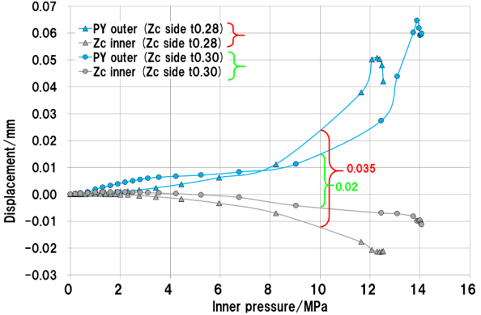
Technical Weekly Report | EDBD | W06 21/Jan – 03/Feb/2022
5
Item/.
Observation in inner pressure increasing (R6 tube) [Back ground ＆ Objective] Zinc can side thickness down has possibility of lower air tight or lower storage characteristics. But reverse connection test may be no burst even if the cap doesn’t have hole for gas venting. [Evaluation] We observed the cap coming off under inner pressure increasing by comparing the zinc can side of t0.30 with that of t0.28. [Result] The clearance between zinc can and PY on the height at below tip of cap is increased more with t0.28 as shown in below graph. Deformation of zinc can side t0.28 was larger that of zinc can side t0.30. The clearance increasing from 0MPa to 10MPa is followings. Zinc can side t0.28 is 0.35mm. Zinc can side t0.30 is 0.02mm. [Consideration] Before cap coming off at 12MPa for t0.28 or 14MPa for t0.30, the gas of t0.28 may go out through zinc can side due to its large clearance. Therefore burst with t0.28 may not occur actually. However if the gas can’t get off in some cases such as large amount of evertack paste, stronger crimping force of zinc can curling by small shoulder height and so on, the burst may occur. Because the 12MPa of t0.28 is smaller than 14MPa of t0.30, t0.28 may not have enough margin for bust if compared with t0.30. [Future activity] These considerations shows some suspicions for possibility of lower margin for burst. Tolerance of max. or min. in battery production such as shoulder height, evertack paste amount and so on had better be examined.
deformation under inner pressure increasing
Cap coming off
Cap coming off
Displacement of zinc can and PY
+ direction of
displacement
on the height at below tip of cap
Cap coming off
t0.28
Cap coming off
t0.30

Slide 6
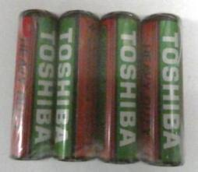
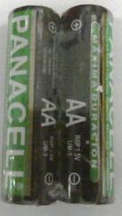
Technical Weekly Report | EDBD | W06 21/Jan – 03/Feb/2022
6
Item/
【Background】 Continue to W02 In order to expand sales in the Latin American market, we conducted research on the trends of other companies and evaluated the performance of other companies' batteries. 【Purpose】 Performance evaluation of other companies in the Peru Market 【Item】 R6:Toshiba/China, Panacell/China Test : Discharge performance (Initial, 45-3M) Heavy metal content 【Result】 When the Toshiba battery is stored at 45 C for 3 months and then subjected to a discharge test, there is the probability of abnormal discharge in Motor mode. The Panacell battery can be used without Any problems. Panacell are environmentally friendly because Pb is not added. The additive of Zinc can is not added, just Pure zinc only. So continue to storage test carefully. See the next chart.

